Slide 1
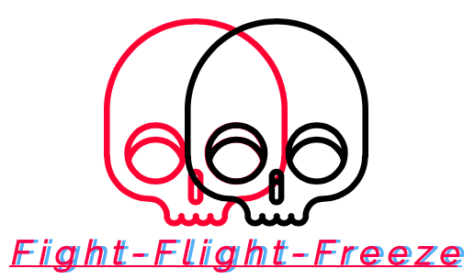
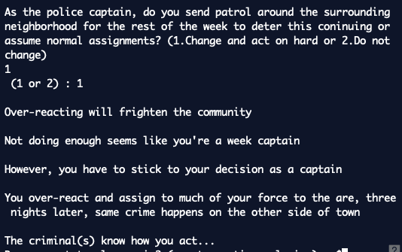
What would you do if somebody broke into your house unannounced? Let’s explore that safely in this story-based app.
Everybody can retrospectively say what they would do in a life or death moment, but few ever hash out how they would do it.
Short-storied based games are one of the leading genres in today’s games.
Death is a complexity that knows no limitation in regard to time or medium.
My short storied app is one that people can work out the “what and how” they would survive in a very relatable and accessible prompt.
The player makes a series of black and white decisions based on the prompt, resulting in a tailored game experience.
Link: https://github.com/ksu-is/Fight-FLight-or-Freeze
By : Justin Hawkins
Story will have you play multiple roles that weaved together into a cohesive narrative that makes you explore all angles of the situation.

